Slide 1

ETL Project
Covid-19

Slide 3
The Team
Project Manager | Karl Ramsay
Oswaldo Moreno | Data Engineer
Swati Dontamsetti | Data Engineer
Amber Martin | Data Analyst
Ana Razak | Data Analyst
Anthony Brown | Data Analyst
Scope | Cross reference popular job boards to complete a full data analysis on Data Science positions in the top cities to determine the impact of the COVID-19 shutdown and build a website to publish results.

Slide 4
Introduction
As cities across the country practice shelter-in-place, businesses that fall outside the definition of non-essential have been forced to close their doors and implement widespread remote working and telecommuting standards.
In recognition of the work from home mandates and forced closing of businesses (such as restaurants, salons and clothing stores), our team decided to conduct an analysis to determine the impact COVID-19 is having on jobs market –Specifically the viability of the data science job market.

Slide 5
Project Overview
US Job Market Tests Positive for COVID-19
The United States has cut nearly 10 million jobs in recent weeks due to the COVID-19 shutdown. In one weeks time, this project will provide an analysis of the impact the COVID-19 shutdown has had on the Data Science job market.
Hypothesis: As new cases of COVID-19 crop up, the number of job postings will decline.
We decided to use Indeed for our job postings search, and we compared the results with the data from the Institute for Health Metrics and Evaluation on COVID-19 cases, to see if our hypothesis is true, and to what degree.
We have the data shown for all of the United States, but we also broke the data down by "Top Cities" for Data Science jobs as provided by DataJobs: New York, Chicago, Boston, San Francisco (Bay Area), and Seattle.

Slide 6
Considerations
Indeed on provides how many days ago a job was posted as it's timestamp on a posting, and it only goes back so far as 30 days. So any jobs posted before 29 days ago shows up as 30+. This means that 30 days ago in our graphs means 30+ days ago.
However, since, most states issued lockdowns around March 19th, which is 32 days ago from the day we collected our data from Indeed (April 20th), this timed out perfectly for our analysis.
This data is all very new and current, so there is no way of creating a longitudinal study. And as both job-postings are limited in their window of staying on websites, and there is no real test-case to compare this too, there is no way to see how our current results compare to other pandemics of the past.

Slide 7

Project Stages

Slide 8
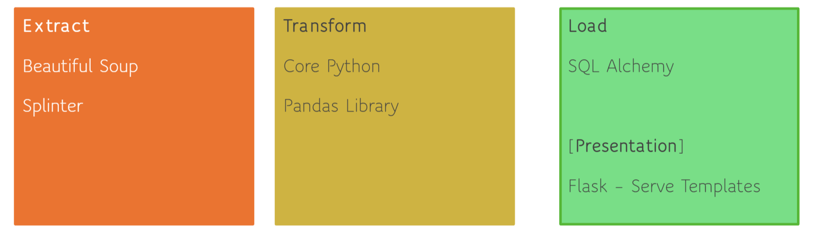
ETL Tools

Slide 9
Extract
We used Beautiful Soup in Jupyter Notebook to scrape data from Indeed. We scraped indeed 5 different times for each of our 5 "Top Cities:" New York, Chicago, Boston, San Francisco (Bay Area), and Seattle. The data we were looking for was the job title, company, location, salary, and date posted from each job posting.
However, because Indeed provides results based on a radius, it gave us results from other cities and neighboring states as well. All the data collected was gathered into one dataframe, which was saved as a CSV.
Our second data source was from the IHME's website. The data was already provided to us as CSV

Slide 10
Transform- Indeed Data
The Indeed Data was cleaned in Jupyter Notebook using Python and the pandas library. The process was many fold.
We had to take out "\n" and replace it was a space every where it appeared.
The day posted column came as a phrase like "18 days ago", but we only wanted the number. So we split the column into many columns using the space. And afterwards, we had to split it by "+" to take it out of the "30+ days ago." And then all the columns, except the one with number, were dropped.
We were then left with the phrase "Today" and "Just", which was part of "Just Now", which had to be replaced with the number 0.
The posted date had to be made negative for when we created our graphs, since the day posted was the number of days AGO from the day the data was gathered.
We then dropped all results where there was no job title present.
As a CSV, the datetime was made into an object, so we had to transform it back into a datetime so that it could used later for math that was done in the COVID-19 Data.

Slide 11
Transform- Covid-19 Data
The data from IHME was comprehensive and provided results from numerous states and many different countries. It also provided more hospital data (like number of ventilators needed and ICU beds used) than we need. The data was first cleaned manually in Excel and then in Jupyter Notebook.
All rows that were the new deaths, new COVID-19 cases, and total deaths were deleted.
All columns that weren't the states of our Top Cities, and over all Country results (USA, New York, Illinois, Massachusetts, California, and Washington) were deleted.
This was then saved as a CSV to be read in Jupyter Notebook
The data column needed to be transformed into datetime, so that, the date in the COVID-19 Data could be subtracted for the date the data was gathered in the Indeed Data to create a column that showed how many days ago the results were taken.
This new column was added to the original COVID-19 data.
The data was first separated into 6 new data frames - one for each state/country - so that data could be plotted over time using the matplotlib.pyplot and numpy libraries

Slide 12
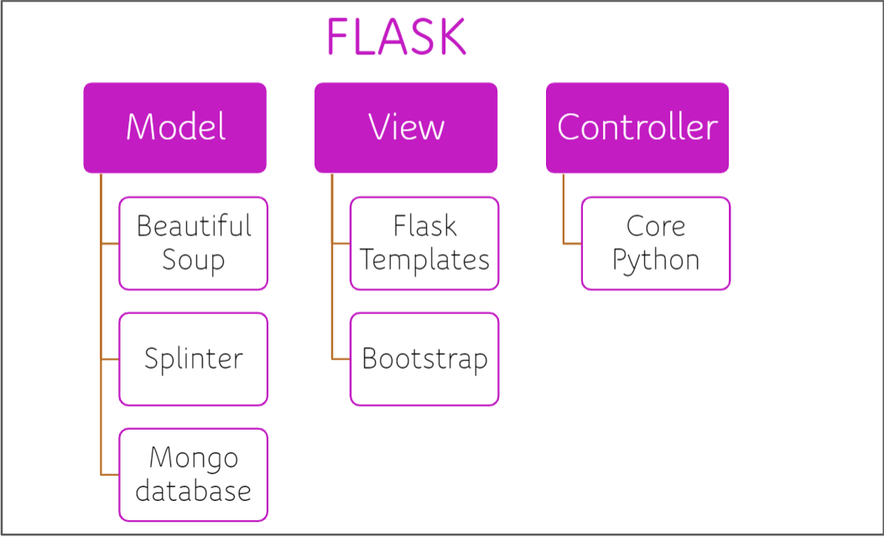
Load
We used the micro-framework Flask inside of Python to create our website that would showcase our data. Both HTML and the Bootstrap library were used to beautify our website.
The final data was stored in a Mongo database, which was used to print our Indeed results. We chose to limit the number of results chosen to 300, because the 18,000 results we had saved would take too long to load on our page.

Slide 13
Results & Analysis
Consideration: Even though we placed job postings and COVID-19 cases on top of each other we should consider prior COVID-19 spikes and dips as affecting future job postings. So, the dip in COVID-19 cases 19 days ago in CA might account for the spike in job postings 17 days ago, and the subsequent spike in COVID-19 cases 17 days ago might account for the dip in job postings 13 days ago.
In general, our hypothesis is correct: as new cases of COVID-19 cropped up, the number of job postings have declined. The degree to which this is true varies from State to State, as seen below.

Slide 14
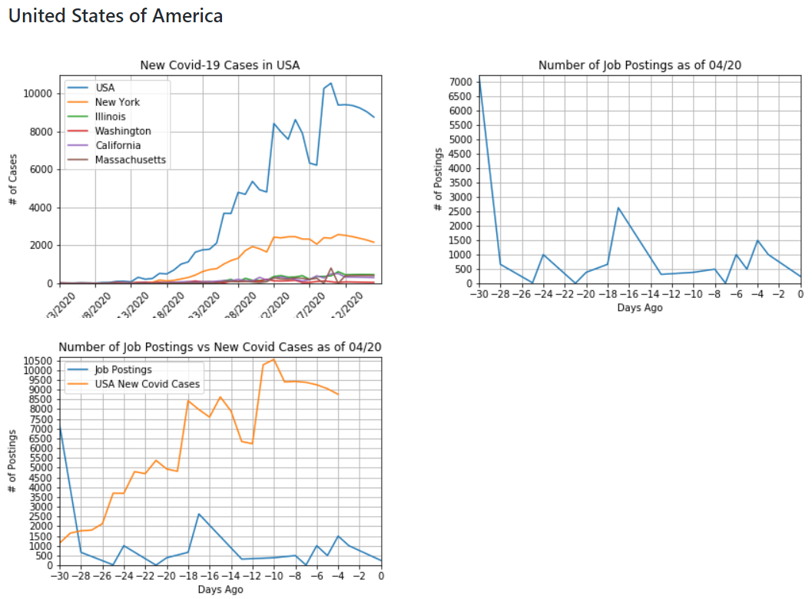
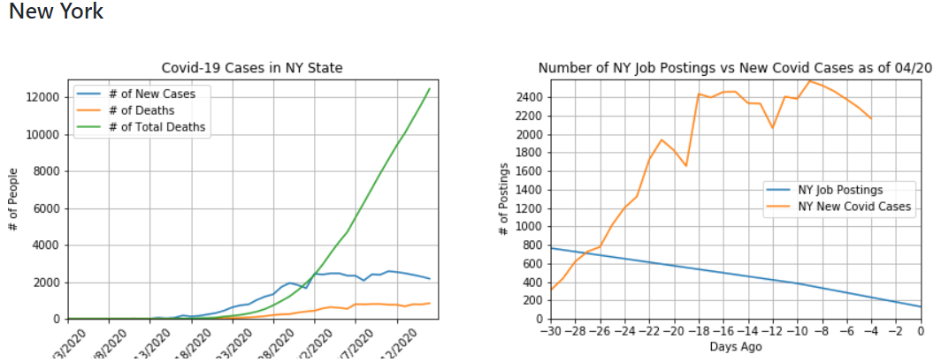
Visual Aids
Analysis: The first COVID-19 cases in the US began 59 days ago on February 21st. From the graphs provided, it is clear, that as new cases of COVID-19 goes up the job postings are, overall, going down.

Slide 15
Links
https://github.com/degree-vs-bootcamp-ROI/ETL-Project
https://github.com/degree-vs-bootcamp-ROI/ETL-Project/blob/master/workflow-tools/updated_indeed.ipynb
https://github.com/degree-vs-bootcamp-ROI/ETL-Project/blob/master/workflow-tools/Covid%20Data.ipynb
https://github.com/degree-vs-bootcamp-ROI/ETL-Project/tree/master/view/templates

